Slide 1
{
title : ’Javascript For everyone’
}

Slide 2


$ whoami
Hengki Sihombing
Founder Karejo.com & Software Engineer OLX
hengkiardo
hengki@karejo.com

Slide 3
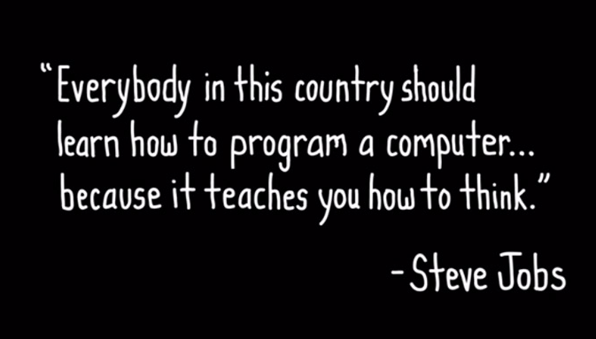
code.learn(You);

Slide 4

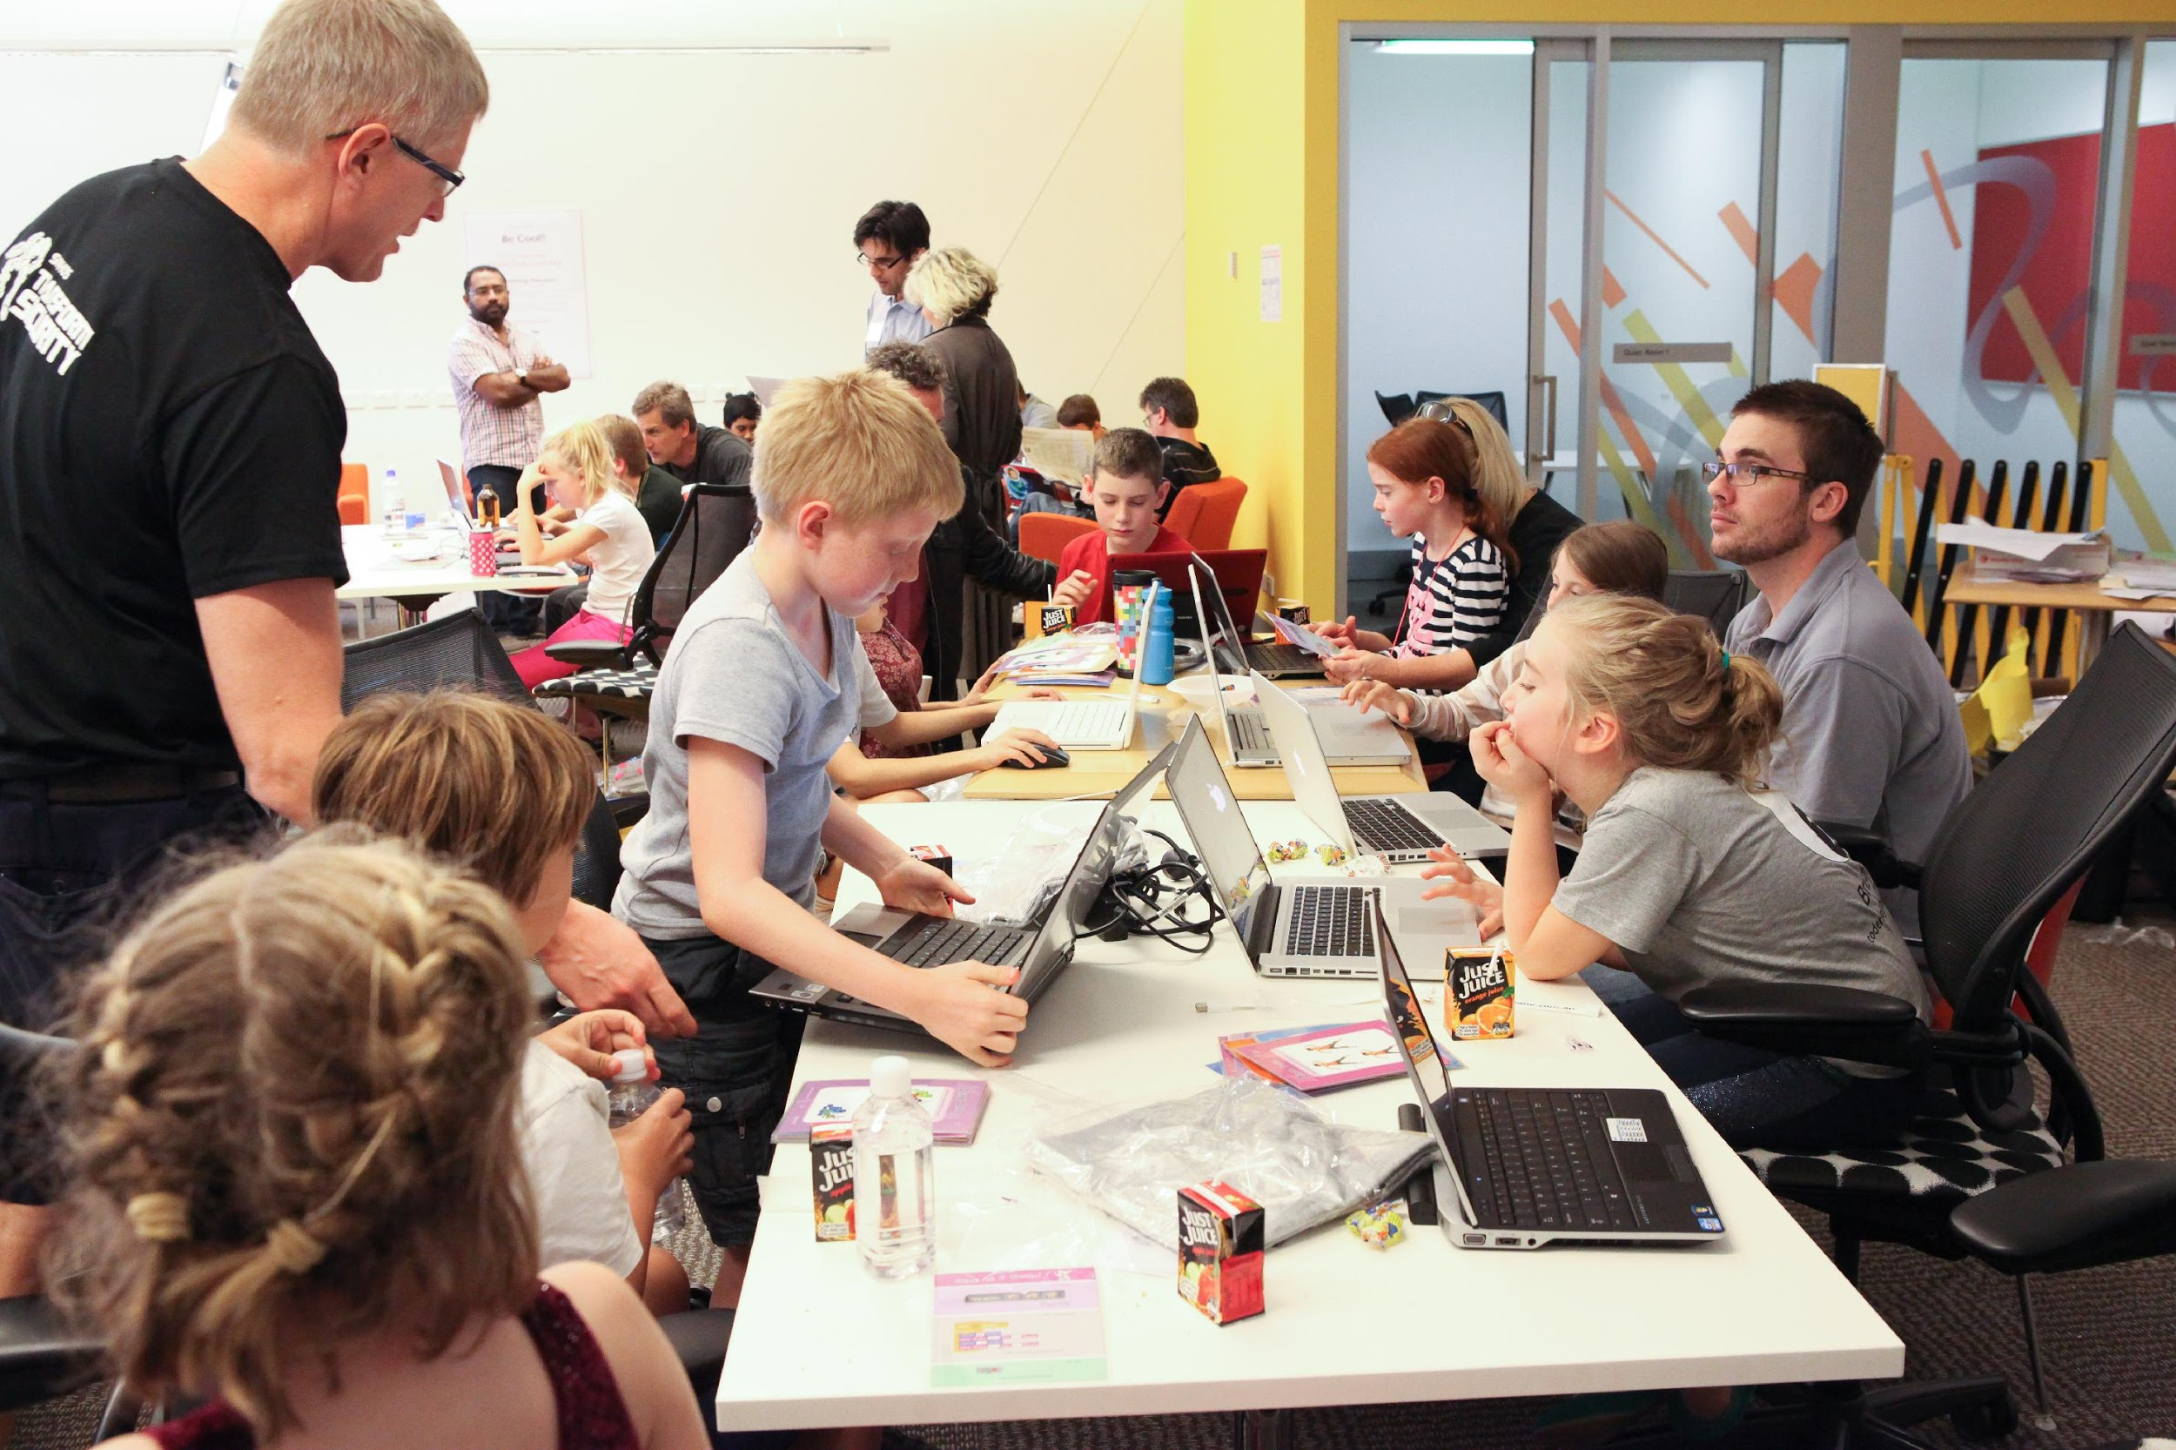
Learn since Kids

Slide 5


Slide 6
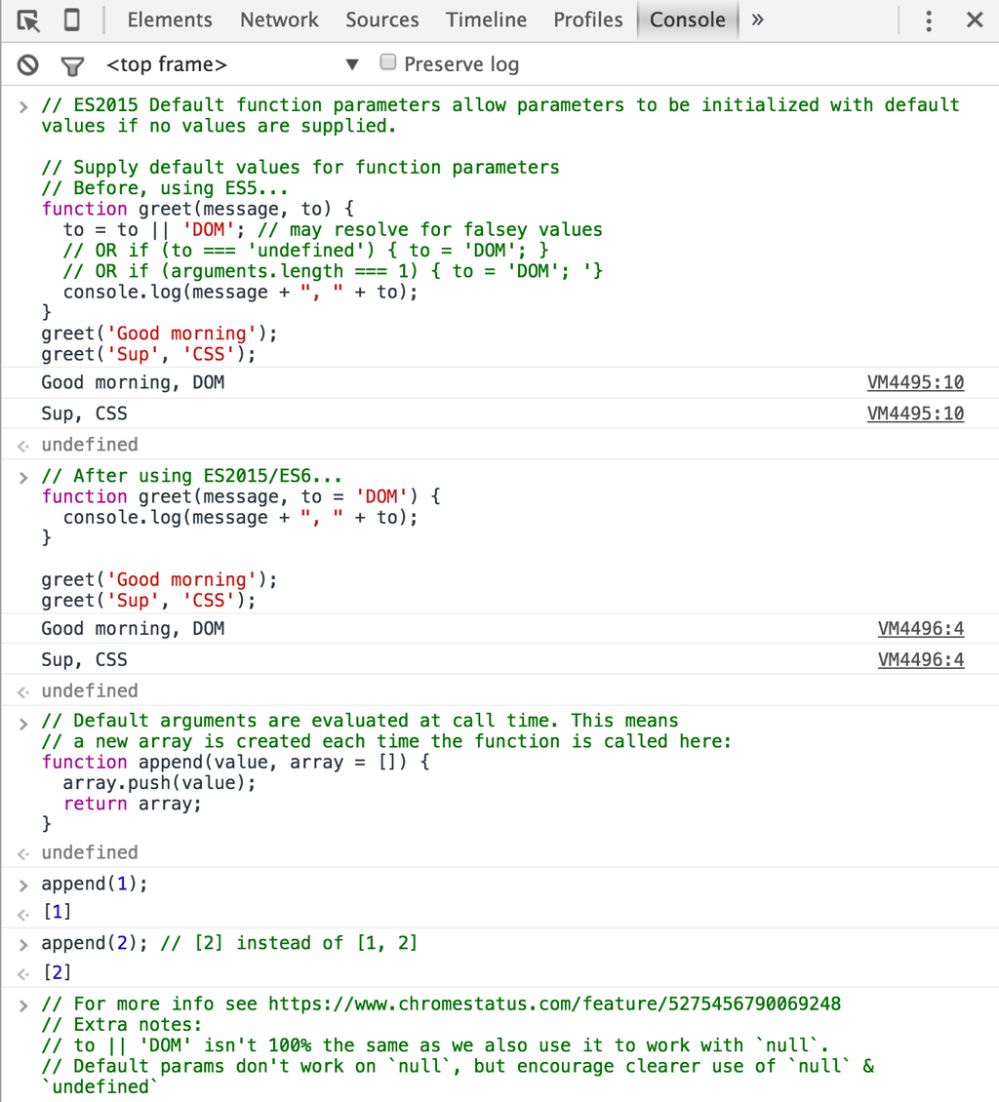
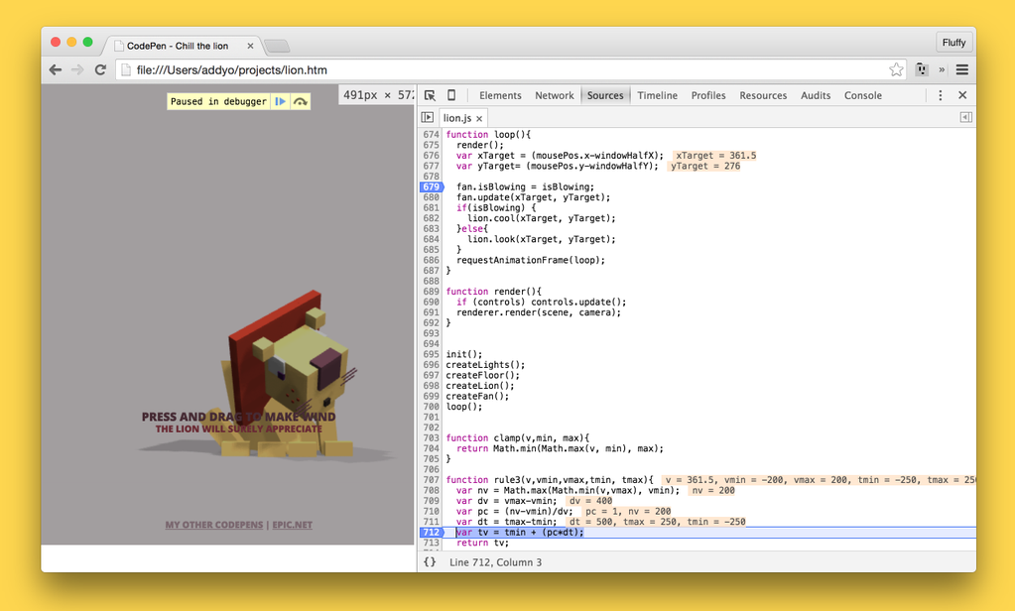
How I Learn Javascript
The only one language you can learn
without Installing the language

Slide 7
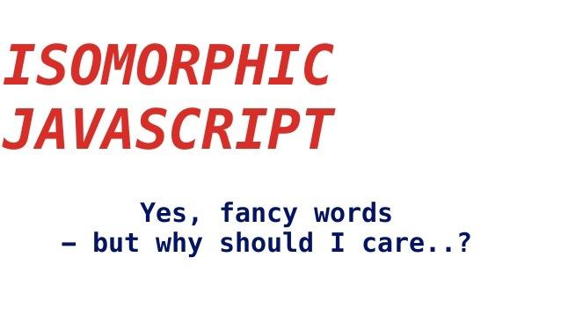

Slide 8
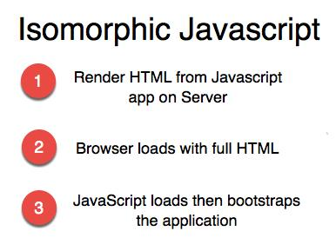
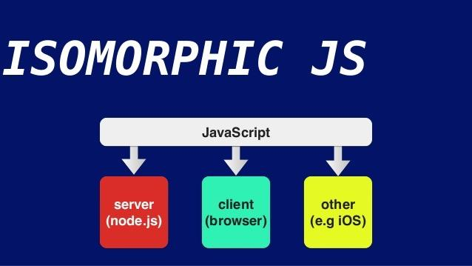

Slide 9


Slide 10
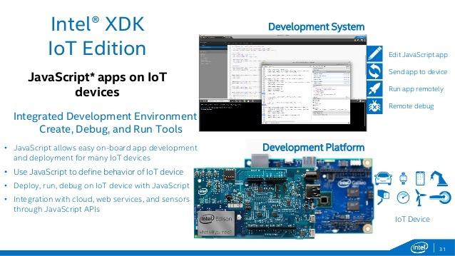
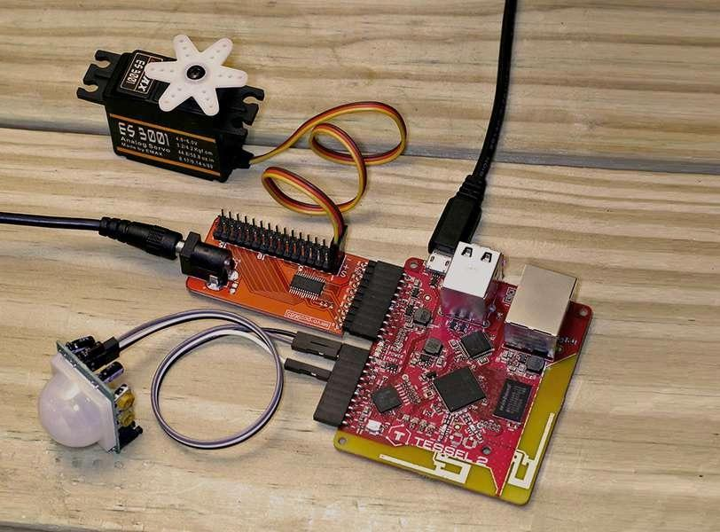
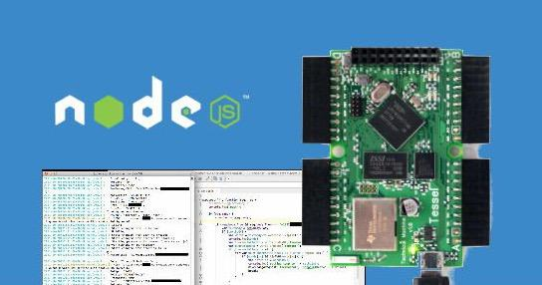

Slide 11
Thank You!

